Slide 1
Drawing Ray Diagrams

Slide 2
By the end of this lesson, you should be able to:
Identify whether images produced by light passing through a lens are real or virtual, upright or inverted and enlarged or diminished.
Construct ray diagrams showing how light rays bend as they pass through convex and concave lenses.

Slide 3
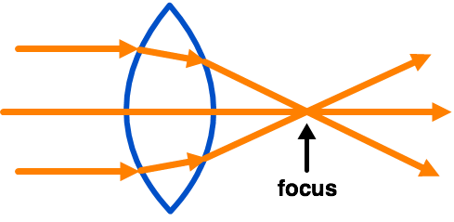
In order to draw a ray diagram, you need to know where a lens' focus is.
The focus is the point where parallel light rays converge.
The diagram below shows the focus of a convex lens.

Slide 4
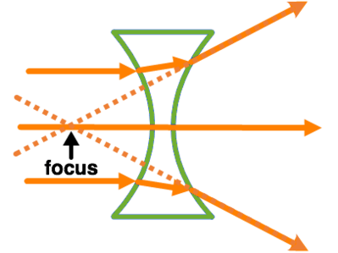
It is slightly harder to find the focus of a concave lens because the rays do not actually cross.
We need to trace the rays backward, behind the lens to find the point where they appear to cross.

Slide 5
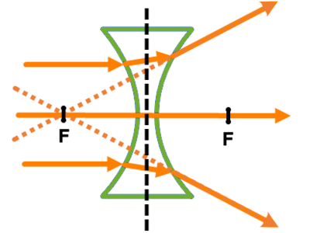
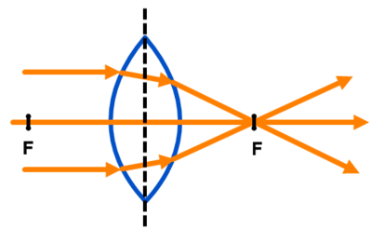
Every lens has two foci (focus points) - one on each side of the lens.
They are the same distance away from the middle of the lens, so you find one focus from the converging rays and use that to find how far away the other focus should be.

Slide 6
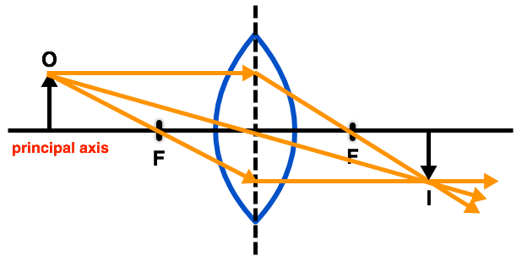
In a ray diagram, the principal axis is the line that runs directly through the centre of the lens.
The foci always occur along the principal axis.

Slide 7

There are three important light rays that we use to find where an image is formed.
We will start by looking at drawing ray diagrams for convex lenses.

Slide 8
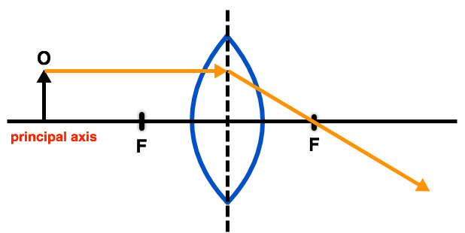
The first ray travels parallel to the principal axis and passes through the focus on the other side of the lens.
We use an arrow labelled with an "O" to show where the object is.

Slide 9
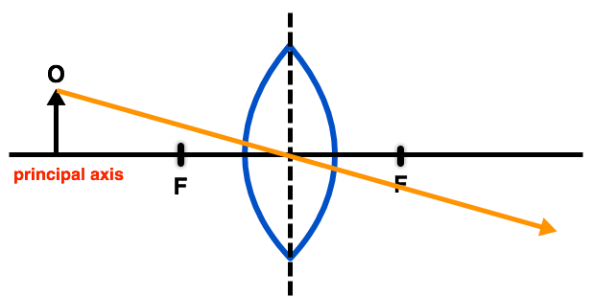
The second ray goes from the object straight through the center of the lens.

Slide 10
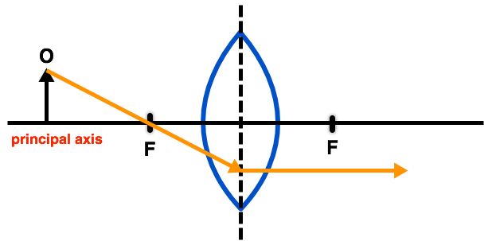
The third ray travels through the focus closest to the object and then travels parallel to the principal axis on the other side of the lens.

Slide 11
When we combine these three rays onto a single ray diagram, we see where the image forms.
The image forms where the light rays cross. We use an "I" to represent the image.

Slide 12
Several different types of image can be formed by a lens.
The image will be either:
1. | Real or virtual.
2. | Enlarged or diminished.
3. | Upright or inverted.

Slide 13
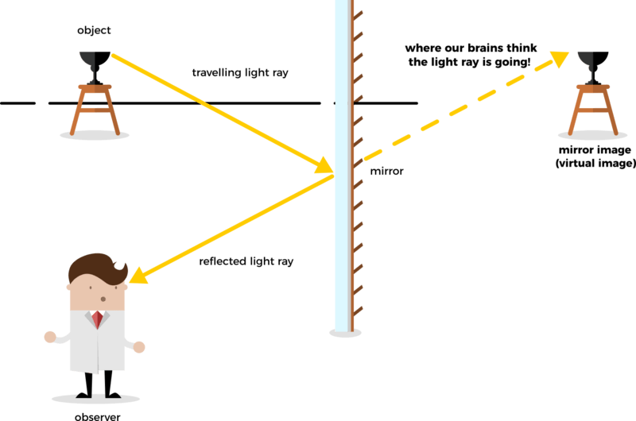
Real Vs. Virtual
A real image is formed when the light rays actually cross; a virtual image is formed when the rays only appear to cross.
Virtual images are formed when diverging rays are traced back to where they appear to cross.

Slide 14
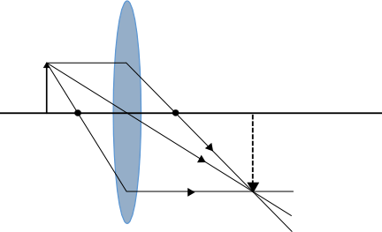
Enlarged Vs. Diminished
An image that is enlarged is bigger than the object; a diminished image is smaller than the object.
We can see the relative size of the image by looking at the arrows that represent the object and image. If the image arrow is longer than the object arrow, it means that the image is enlarged and vice versa.

Slide 15
Upright Vs. Inverted
An image is upright if the image arrow is pointing up; it is inverted if the image is pointing down. This means that the image is upside down.
For example, the image in the ray diagram below is inverted.

Slide 16

The type of image is determined by the type of lens and the location of the object.
In this section, we will look at the different types of images formed by convex lenses.

Slide 17
When the object is beyond or outside the focus we get the following ray diagram:

Slide 18
The image formed by this is real, inverted and diminished.
When you draw ray diagrams you should always use a ruler to check the length of the image arrow.

Slide 19
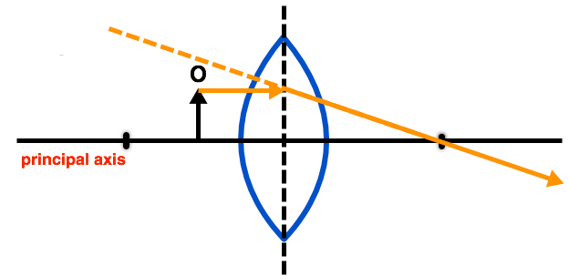
We can also put the object between the focus and the lens.
When this happens the first ray acts the same as it did before. We just need to trace it backwards behind the lens.

Slide 20
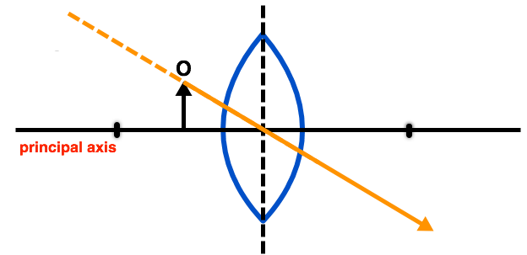
The second ray goes straight from the object through the center of the lens.
The only difference is that we also need to trace this ray backwards.

Slide 21
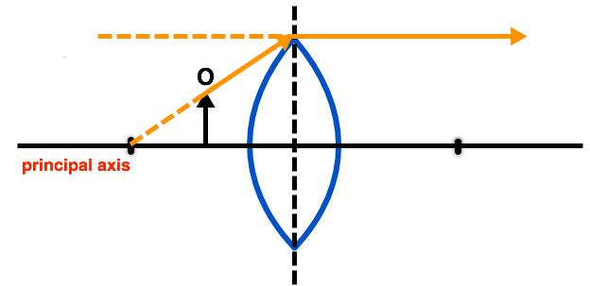
The third ray goes through the focus on the objects' side of the lens; it then goes parallel to the principal axis.
We extend the parallel section of the ray backwards.

Slide 22
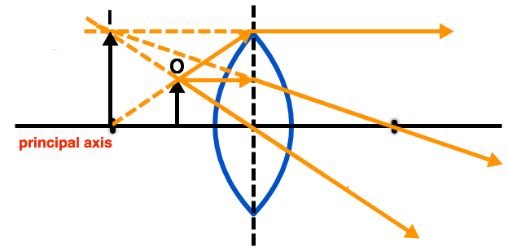
When we combine these three rays into a single ray diagram we get a virtual, upright, enlarged image.

Slide 23
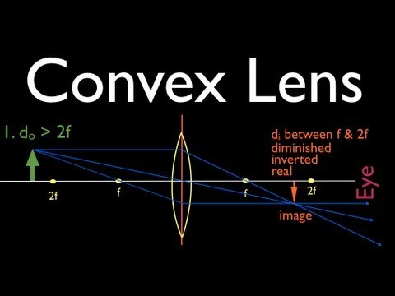

Slide 24

Concave lenses are slightly harder to make ray diagrams for.
However, the images that they form are always virtual, diminished and upright.

Slide 25
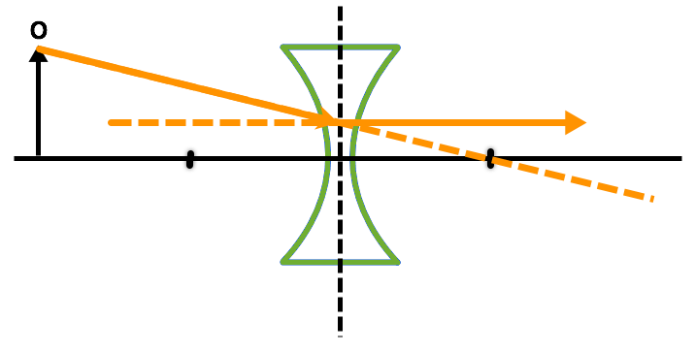
The first ray goes towards the focus on the opposite side of the lens; it then travels parallel to the principal axis.
We trace the parallel section of the ray backwards.

Slide 26
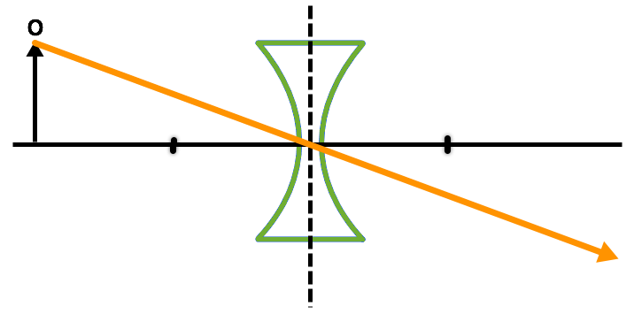
The second ray extends from the object straight through the centre of the lens.

Slide 27
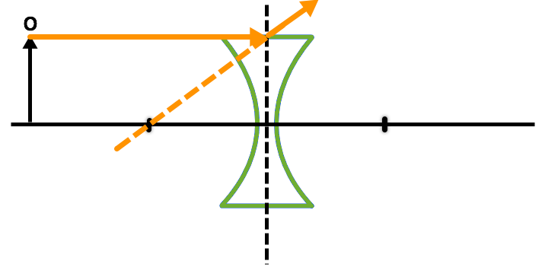
The third ray starts off parallel to the principle axis.
It then diverges away from parallel as it passes through the lens. We can determine the angle at which this ray diverges because we can trace it back through the focus that is on the same side as the image.

Slide 28
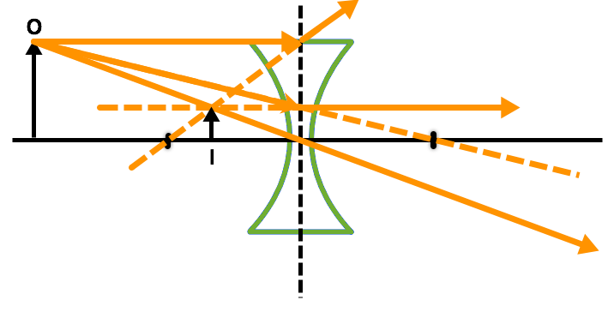
When we combine the rays we get the following ray diagram:
The image is virtual, diminished and upright, just like we expected.

Slide 29
